Slide 1
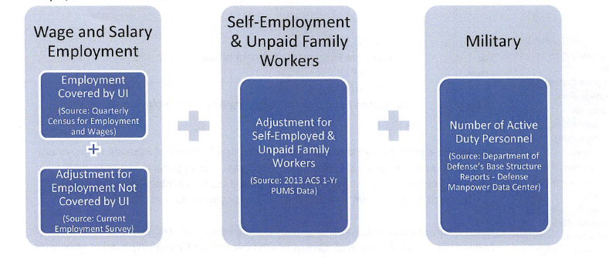
ESTIMATING EMPLOYMENT
IN ARLINGTON COUNTY
Data Science for the Public Good
Madison Arnsbarger (Virginia Tech); Millicent Grant (Iowa State); Samantha Tyner (Iowa State)
with Vicki Lancaster (SDAL); Elizabeth Hardy & Andrew D’huyvetter (Arlington Demographers)
The Issue
Arlington County demographers have expressed concern regarding the data sources used by the Metropolitan Washington Council of Governments (MWCOG) to estimate employment. These estimates are used to apportion transportation funds to the 22 local governments in the MWCOG. The demographers hypothesize the employment estimate for Arlington County has a downward bias resulting in a loss of transportation funds. Their concerns with the data sources used by MWCOG are:
Inaccurate reporting of the number of federal civilian, contract, and military employees.
Inaccurate reporting of employee worksite locations from those companies that do not comply with Virginia’s multiple worksite reporting law.
Inaccurate or missing addresses in the employment data sources.
MWCOG Employment Estimation
Limitations of the Data Sources
Many federal employees work in Arlington County.
The administrative data sources used by MWCOG to quantify federal employment are the Quarterly Census for Employment and Wages (QCEW) and the Defense Structure Reports.
In the QCEW, employees not covered by unemployment insurance are not included. Employer addresses are often missing, inaccurate, or out-of-date.
In both sources, federal civilian, contract, and military employees can be excluded from the count for national security reasons.
Approaches to Validating Federal Employment
SDAL ideas for validating federal employment in Arlington County.
Supplementing the Data Sources. Construct a data set of federal work sites by merging together alternative data sources such as, GSA federal leasing data, Base Realignment and Closure reports, federal employment data from OPM and Census, commercial employment data from CoStar and InfoUSA, a Washington Post article on secret government organization and contractors, internet information on the location of federal agencies, demographer institutional knowledge. The QCEW data will be checked against the merged data sources each quarter to construct a body of evidence that can used to validate QCEW employment numbers and quantify any bias.
Surrogates for Employment. Evaluate whether building occupancy measures such as water, sewer, and cell phone usage data can be used as surrogates for employment at federal facilities.
3. Geocoding and address verification. Document geocoding issues and compile recommendations for collecting accurate address information.
Proof of Concept: Water Usage
There are a number of factors to consider when using building water usage as a surrogate for office building occupancy: restrooms, kitchens, showers, cooling, landscaping, and commercial occupants.
Figure:
The figure at right shows the average water usage (in 1000s of gallons) per floor and per business day by 3 LEED certified buildings in AC.
The dotted lines connect the meter readings and the solid lines show mean estimates of water usage, with standard error estimates shown in gray.
These three buildings are very different: green – only office space; red – apartments and retail; blue – 3 restaurants, retail, a yoga studio, and office space.
These 3 buildings demonstrate the difficulty of using water to estimate employment.
One needs to account for the retail, restaurant, office, and apartment space in each building to estimate the number of people working in the building.
References
NCHRP 08-36, Task 098 Improving Employment Data for Transportation Planning http://onlinepubs.trb.org/onlinepubs/nchrp/docs/NCHRP08-36%2898%29_FR.pdf
Top Secret America A Washington Post Investigation (July 2010) http://projects.washingtonpost.com/top-secret-america/articles/
bi.vt.edu/sdal

